Slide 1

IT 353 Web Development Technologies
Jianwei Lai
jlai12@ilstu.edu

Slide 2
Today’s Content
3 types of scope:
Global scope
Local scope
Block scope
Create a countdown clock

Slide 3
Global Scope
Variables declared Globally (outside any function) have Global Scope.
var a = 123;
console.log(window.a); // 123
myFunction(); // code here can use carName function myFunction() { carName = "Volvo"; }
If you assign a value to a variable that has not been declared, it will automatically become a GLOBAL variable.
https://www.w3schools.com/js/tryit.asp?filename=tryjs_local_global
Notes:
Add var before carName = "Volvo";
<!DOCTYPE html>
<html>
<head>
<title>Page Title</title>
<script src="script1.js"></script>
<script src="script2.js"></script>
</head>
<body>
<h1>This is a Heading</h1>
<p id="paragraph">This is a paragraph.</p>
<script src="script3.js"></script>
</body>
</html>
in script1.js file
var a = 123;
in script2.js file
var a = 456;
In script3.js file
console.log(window.a);
document.getElementById("paragraph").innerHTML=a;
Change var to let
put var in a self-invoking function
(function invokeMyself(){
var a = 123;
})();

Slide 4
Strict Mode of JavaScript
In "Strict Mode", undeclared variables are not automatically global.
"use strict"; Defines that JavaScript code should be executed in "strict mode".
The purpose of "use strict" is to indicate that the code should be executed in "strict mode".
With strict mode, you can not, for example, use undeclared variables.
All modern browsers support "use strict" except Internet Explorer 9 and lower:
https://www.w3schools.com/js/tryit.asp?filename=tryjs_strict_variable
Notes:
Add alert to see if alert works. Then remove “user strick” to see if alert works.
<script>
"use strict";
x = 3.14; // This will cause an error (x is not defined).
alert(x);
All code you write should be in strict mode. It helps you catch mistakes by not ignoring exceptions.
First, strict mode eliminates some JavaScript silent errors by changing them to throw errors. Second, strict mode fixes mistakes that make it difficult for JavaScript engines to perform optimizations: strict mode code can sometimes be made to run faster than identical code that's not strict mode

Slide 5
'use strict';
// If this is a .js file, you can enable strict mode by putting // 'use strict' as the first statement in the file. You can put // comments before 'use strict' 'use strict';
function foo() { 'use strict'; // Even if the code outside of 'foo' isn't using strict mode, the code // inside `foo()`'s function body will use strict mode }
https://masteringjs.io/tutorials/fundamentals/strict

Slide 6
Global Scope
Do NOT create global variables unless you intend to.
Your global variables (or functions) can overwrite window variables (or functions).
Any function, including the window object, can overwrite your global variables and functions.
https://www.w3schools.com/js/tryit.asp?filename=tryjs_local_global
Notes:
Override the window alert function
<script>
window.alert = function() {
// do something here
document.getElementById("demo").innerHTML = "I override the alert function";
};
alert(“alert”);

Slide 7
How to avoid global variables?
(function() { // Begin scoping function
})();

Slide 8
Local Scope
Variables declared within a JavaScript function, become LOCAL to the function.
// code here can NOT use carName function myFunction() { let carName = "Volvo"; // code here CAN use carName } // code here can NOT use carName
https://www.w3schools.com/js/tryit.asp?filename=tryjs_scope_local
Notes:
Change to var to see

Slide 9
Block Scope
Before ES6 (2015), JavaScript had only Global Scope and Function Scope.
ES6 introduced two important new JavaScript keywords: let and const.
These two keywords provide Block Scope in JavaScript.
Variables declared inside a { } block cannot be accessed from outside the block:
{ let x = 2; } // x can NOT be used here
Notes:
Change let to var, still block scope?

Slide 10
if (true) {
// "if" block scope const message = 'Hello'; console.log(message); // 'Hello’
}
console.log(message); // throws ReferenceError
Notes:
https://dmitripavlutin.com/javascript-scope/
Change to var to see the difference
var is not bock scoped.

Slide 11
<script>
var funcs = [];
// let's create 3 functions
for (var i = 0; i < 3; i++) {
// and store them in funcs
funcs[i] = function() {
// each should log its value.
console.log("My value: " + i);
};
}
//console.log (i);
funcs [0]();
funcs [1]();
funcs [2]();
</script>
https://stackoverflow.com/questions/750486/javascript-closure-inside-loops-simple-practical-example
Notes:
your myFunctions() is bound to outer-scope variable i which is changed in each loop so after complete loops it value is 3, that is the reason it is printing 3 each time.
http://conceptf1.blogspot.com/2013/11/javascript-closures.html
in a loop with a let-based index, each iteration through the loop will have a new variable i with loop scope

Slide 12
let | var
let is block-scoped. | var is not block-scoped.
let does not allow to redeclare variables. | var allows to redeclare variables.
Hoisting does not occur in let. | Hoisting occurs in var.
Notes:
https://www.programiz.com/javascript/let-vs-var
Hoisting -- In JavaScript, a var variable can be declared after it has been used.
https://www.w3schools.com/js/tryit.asp?filename=tryjs_hoisting1

Slide 13
Build a countdown clock
https://www.sitepoint.com/build-javascript-countdown-timer-no-dependencies/
http://codepen.io/SitePoint/pen/MwNPVq

Slide 14
Methods used
new Date(): current date and time
Date.parse(): returns the number of milliseconds since January 1, 1970, 00:00:00 UTC
element.querySelector(): Returns the first element that is a descendant of the element
.slice(-2): get the last 2 characters
setInterval(): repeatedly calls a function or executes a code snippet
Math.floor(): function returns the largest integer less than or equal to a given number.

Slide 15
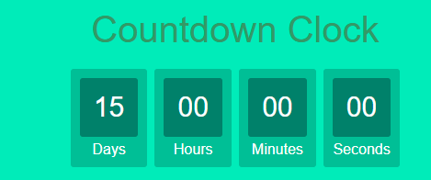
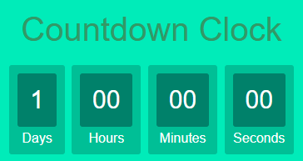
Try: starting countdown with 1 day

Slide 16
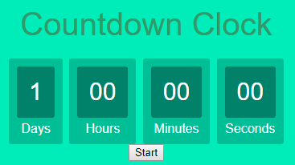
Add a start button to start countdown
<div> <button type="button">Start</button> </div>

Slide 17
Question for you: how to start countdown by clicking the start button?
<button type="button" onclick= "startCountDown()">Start</button>
function startCountDown(){
…
}

Slide 18
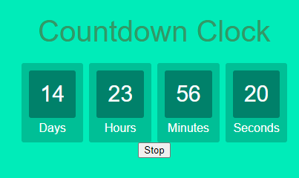
Try: change “start” button to “stop”
Notes:
var timeinterval;
function startCountDown (){
let button = document.getElementById("btn");
if (button.innerText =="Start"){
button.innerHTML = "Stop";
initializeClock();
} else {
//stop timer
button.innerHTML = "Start";
clearInterval(timeinterval);
}
}
function initializeClock(){
var deadline = new Date(Date.parse(new Date()) + 15 * 24 * 60 * 60 * 1000); /*new Date(): current date and time; Date.parse(): returns the number of milliseconds since January 1, 1970, 00:00:00 UTC*/
var clock = document.getElementById("clockdiv");
var daysSpan = clock.querySelector('.days'); /* select the days class within the clock class*/
var hoursSpan = clock.querySelector('.hours');
var minutesSpan = clock.querySelector('.minutes');
var secondsSpan = clock.querySelector('.seconds');
clearInterval(timeinterval);
timeinterval = setInterval(updateClock, 1000); /*setInterval(): repeatedly calls a function or executes a code snippet*/
function updateClock() {
var t = getTimeRemaining(deadline);
daysSpan.innerHTML = t.days;
hoursSpan.innerHTML = ('0' + t.hours).slice(-2); /* get the last 2 characters*/
minutesSpan.innerHTML = ('0' + t.minutes).slice(-2);
secondsSpan.innerHTML = ('0' + t.seconds).slice(-2);
if (t.total <= 0) {
clearInterval(timeinterval);
}
}
}
function getTimeRemaining(endtime) {
//var t = Date.parse(endtime) - Date.parse(new Date());
var t = Date.parse(endtime) - Date.parse(new Date());
var seconds = Math.floor((t / 1000) % 60);
var minutes = Math.floor((t / 1000 / 60) % 60);
var hours = Math.floor((t / (1000 * 60 * 60)) % 24);
var days = Math.floor(t / (1000 * 60 * 60 * 24));
return {
'total': t,
'days': days,
'hours': hours,
'minutes': minutes,
'seconds': seconds
};
}

Slide 19
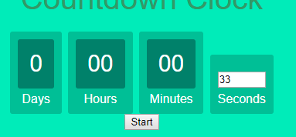
Try: let users set the time for countdown
Users can set the number in the text field

Slide 20
Try: let users set the time for countdown
<input type="number" class="seconds" min="1" max="60" id="second">
<!-- <span class="seconds"></span> -->
var second = parseInt(document.getElementById("second").value);
var deadline = new Date(Date.parse(new Date()) + second * 1000);
secondsSpan.value= ('0' + t.seconds).slice(-2); //secondsSpan.innerHTML = ('0' + t.seconds).slice(-2);

Slide 21
Try: after starting, make text fields not editable
document.getElementById("second").readOnly = true;
Notes:
var timeinterval;
function startCountDown (){
let button = document.getElementById("btn");
if (button.innerText =="Start"){
button.innerHTML = "Stop";
initializeClock();
} else {
//stop timer
button.innerHTML = "Start";
clearInterval(timeinterval);
}
}
function initializeClock(){
//var deadline = new Date(Date.parse(new Date()) + 15 * 24 * 60 * 60 * 1000); /*new Date(): current date and time; Date.parse(): returns the number of milliseconds since January 1, 1970, 00:00:00 UTC*/
var second = parseInt(document.getElementById("second").value);
var deadline = new Date(Date.parse(new Date()) + second * 1000);
var clock = document.getElementById("clockdiv");
var daysSpan = clock.querySelector('.days'); /* select the days class within the clock class*/
var hoursSpan = clock.querySelector('.hours');
var minutesSpan = clock.querySelector('.minutes');
var secondsSpan = clock.querySelector('.seconds');
clearInterval(timeinterval);
timeinterval = setInterval(updateClock, 1000); /*setInterval(): repeatedly calls a function or executes a code snippet*/
function updateClock() {
var t = getTimeRemaining(deadline);
daysSpan.innerHTML = t.days;
hoursSpan.innerHTML = ('0' + t.hours).slice(-2); /* get the last 2 characters*/
minutesSpan.innerHTML = ('0' + t.minutes).slice(-2);
//secondsSpan.innerHTML = ('0' + t.seconds).slice(-2);
secondsSpan.value= ('0' + t.seconds).slice(-2);
if (t.total <= 0) {
clearInterval(timeinterval);
}
}
}
function getTimeRemaining(endtime) {
//var t = Date.parse(endtime) - Date.parse(new Date());
var t = Date.parse(endtime) - Date.parse(new Date());
var seconds = Math.floor((t / 1000) % 60);
var minutes = Math.floor((t / 1000 / 60) % 60);
var hours = Math.floor((t / (1000 * 60 * 60)) % 24);
var days = Math.floor(t / (1000 * 60 * 60 * 24));
return {
'total': t,
'days': days,
'hours': hours,
'minutes': minutes,
'seconds': seconds
};
}

Slide 22
In-class practice 2 due tonight

Slide 23
Assignment 2 on Reggienet due 9/23
Create a website including:
At least 3 pages. For example, if you want to create a personal website, you can add home, about, contact, resume, etc. (3 points)
An external CSS file for styles (2 points). The style sheet should be put in a folder called “styles”
A navigation bar for all pages so that all pages are linked (2 points)
Use Semantic tags, such as header, footer, etc., when necessary (1 point)
Add pictures to your pages. Pictures should be put in a folder called “images”. (2 points)
Add a function you like with JavaScript for 1 extra point.
Zip all files and submit to Reggienet by 9/22

